Slide 1

Session Name:
Presentation of Data
Delivered By:
Vikash Singh

Slide 2

Learning Objectives
By the end of this session, you will be able to:
Understand diagrammatic presentation of data
Identify and construct bar, pie, pictogram, and cartogram diagrams
Understand the importance of data visualization
Apply rules for effective diagrams
Reference Python Code

Slide 3
Why Diagrammatic Presentation?
Advantages:
- Easy to interpret
- Visually appealing
- Aids comparison and decision-making
Limitations:
- May distort data
- Not suitable for exact values
- Can mislead if wrongly scaled

Slide 4
General Visualization Rules
Use proper title and labels
01
Maintain consistent scale
02
Keep diagrams simple and readable
03
Use legend and color codes when needed
04

Slide 5
Common Visualization Techniques
Line Charts: Best for tracking data over time (e.g., COVID cases).
Bar Charts: Effective for comparing categories.
Pie Charts: Visualizing part-to-whole relationships.
Scatter Plots: Showing relationships between variables.
Heat Maps: Visualizing density or intensity of data.

Slide 6
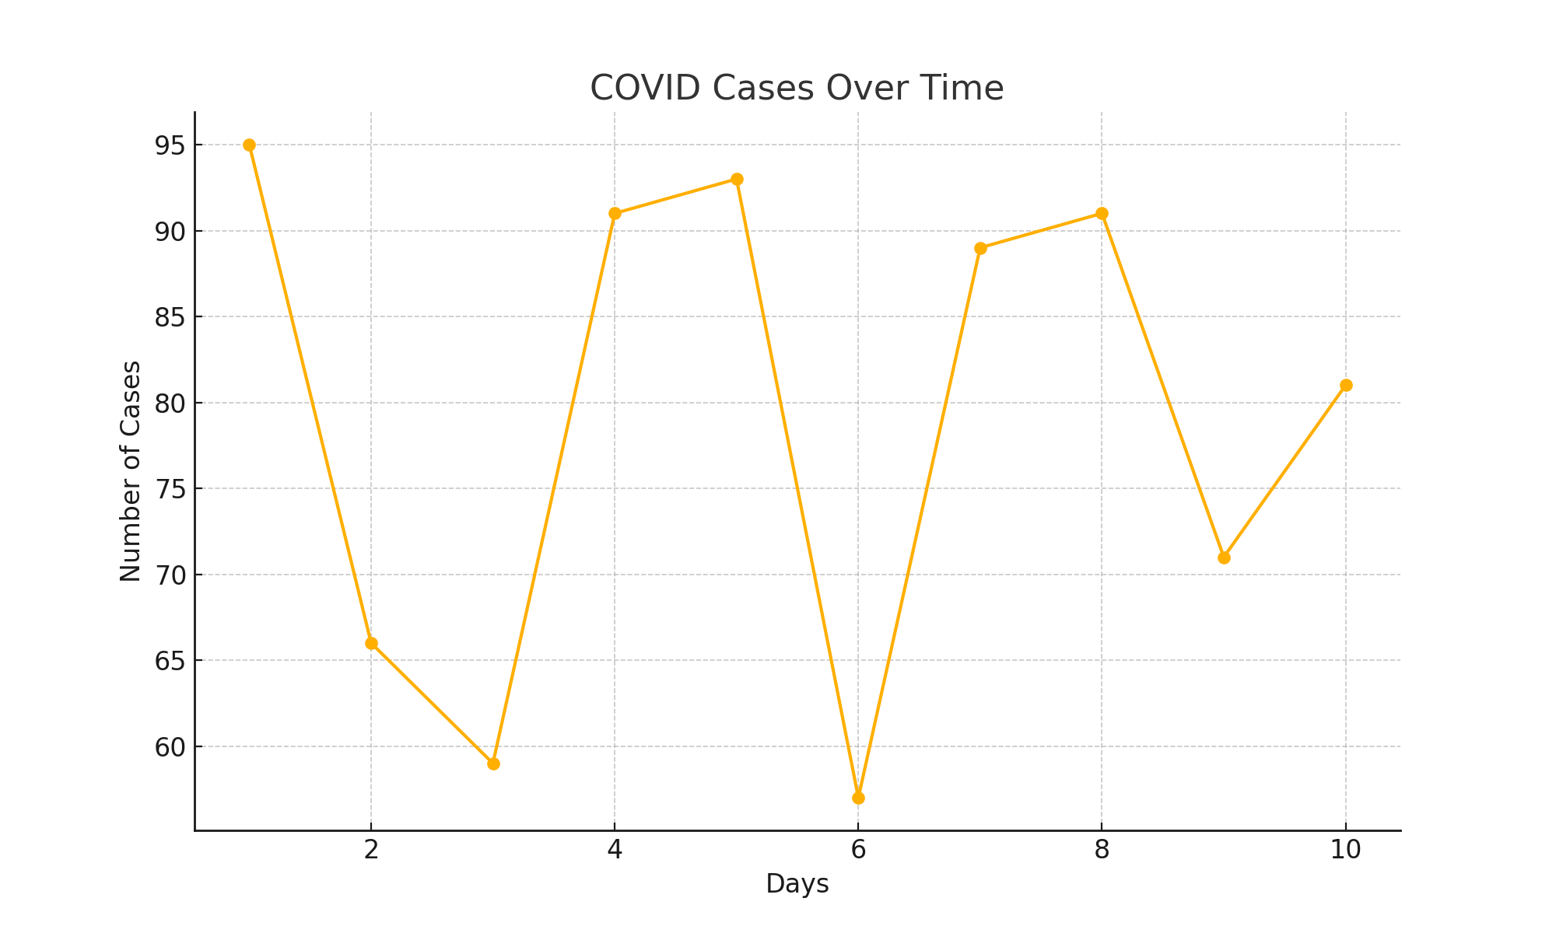
Line Chart Example: COVID Cases Over Time

Slide 7
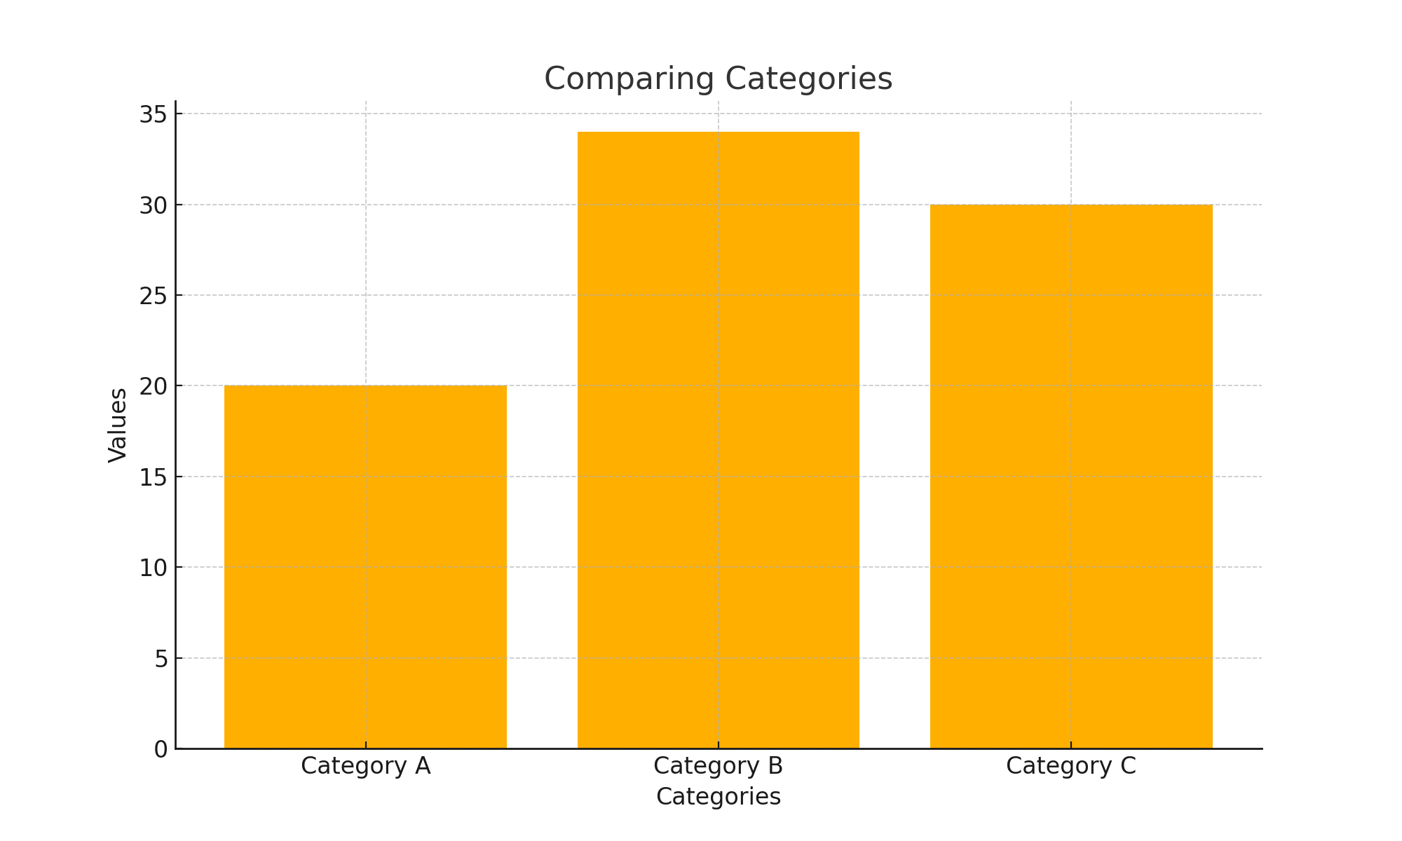
Bar Chart Example: Comparing Categories

Slide 8
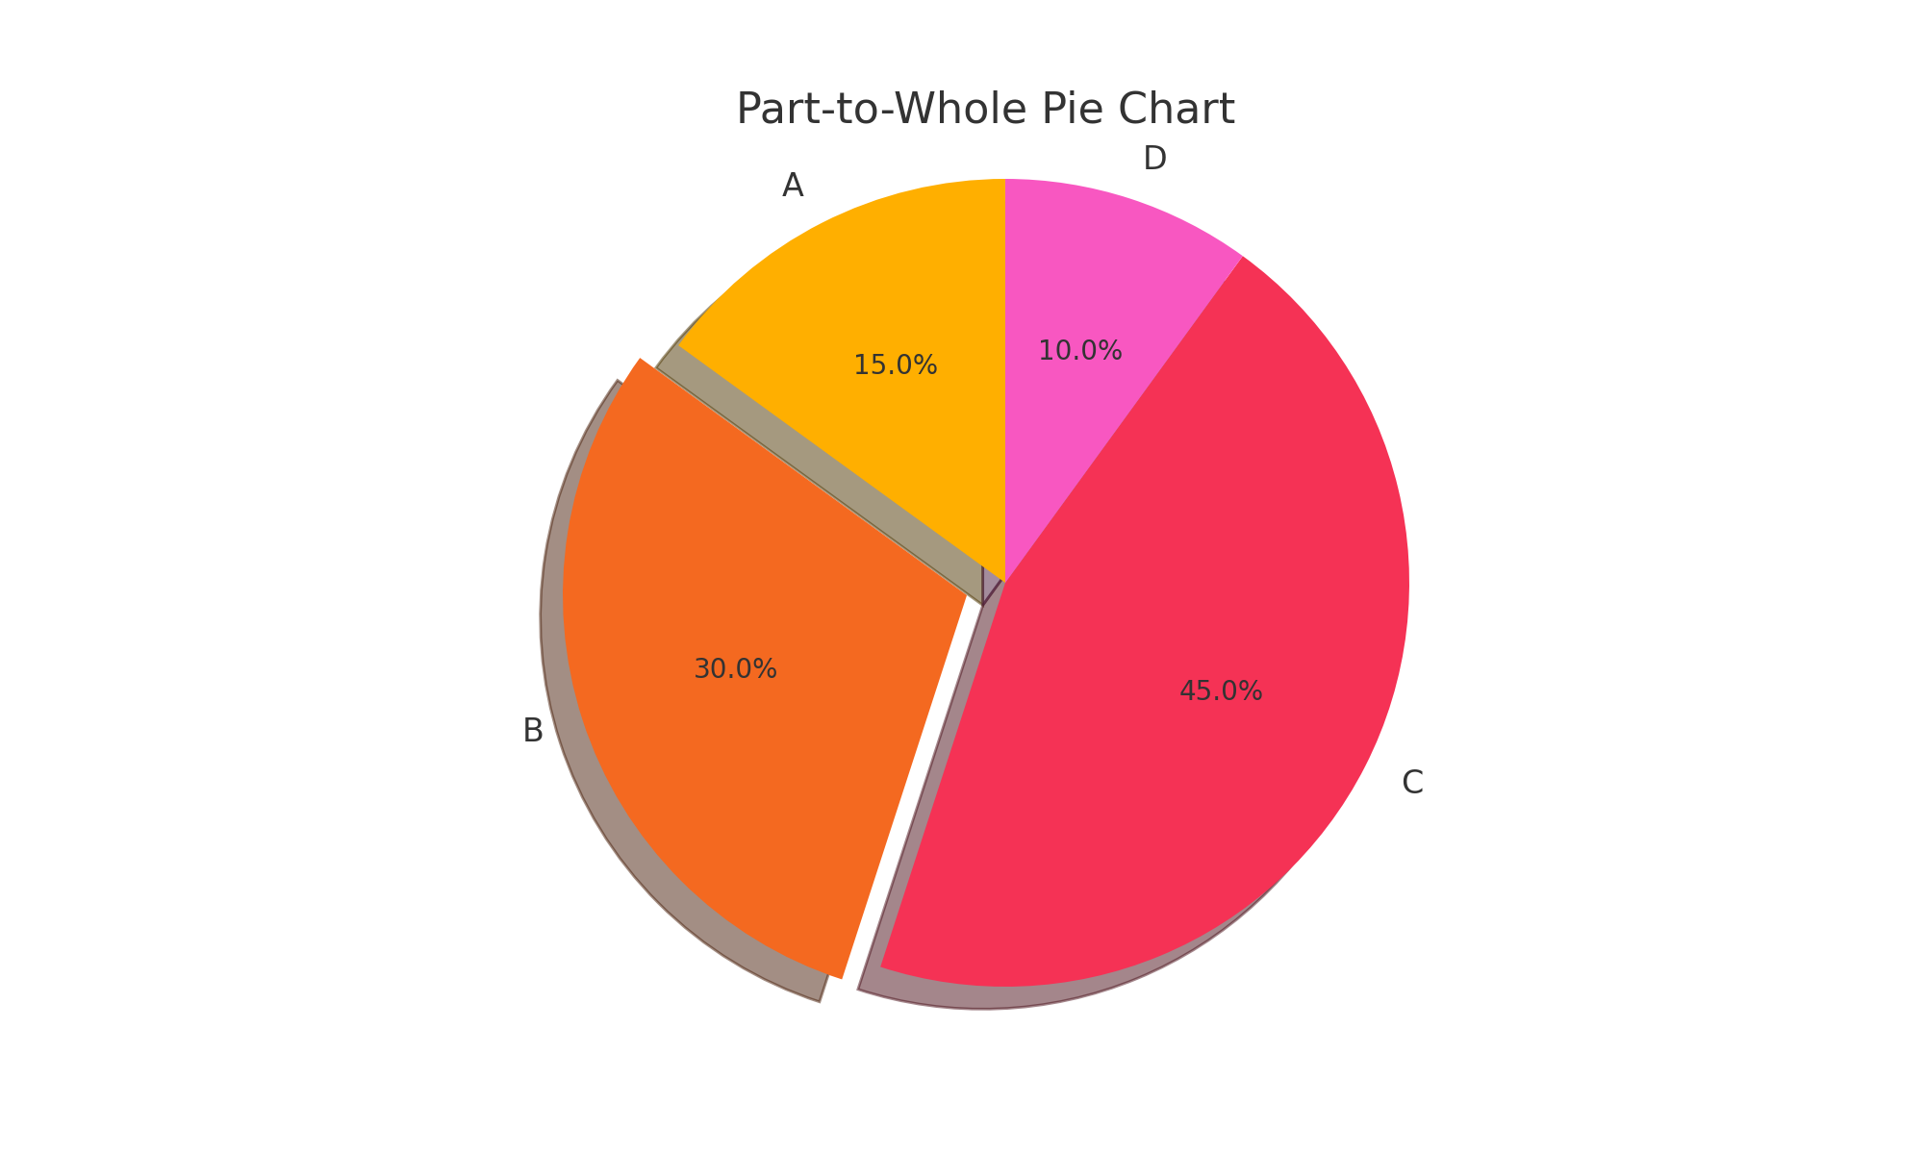
Pie Chart Example: Part-to-Whole

Slide 9
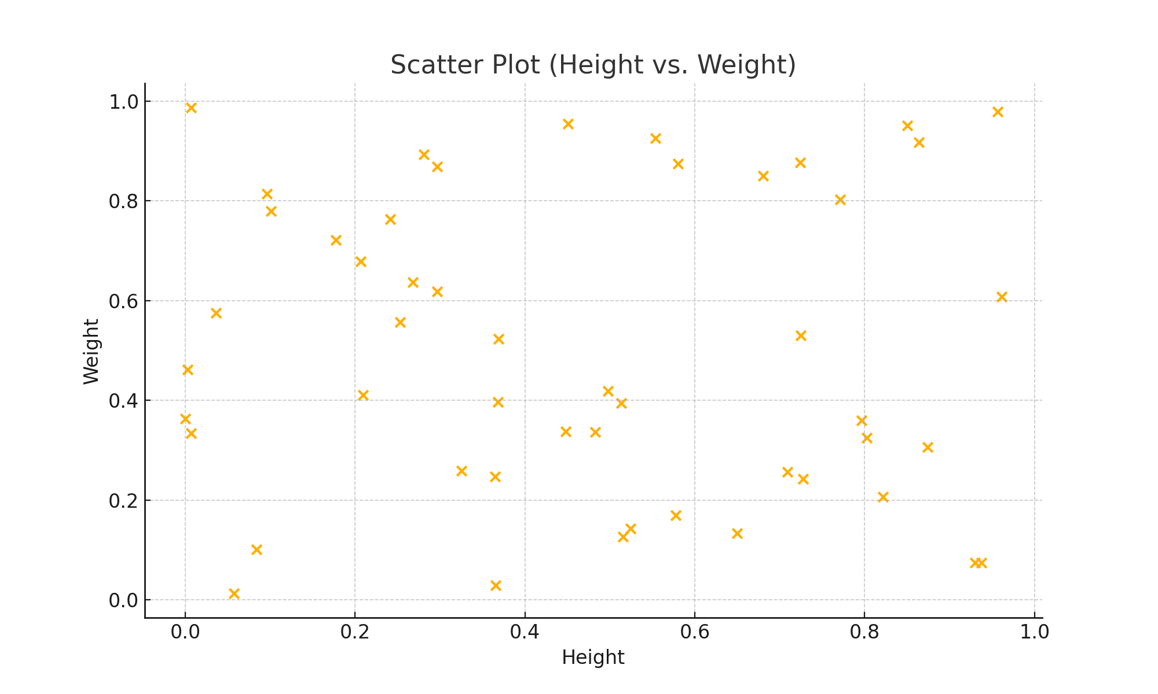
Scatter Plot Example: Height vs Weight

Slide 10
How to Choose the Right Visualization
Identify the type of data you are working with.
Understand the audience and the message you want to convey.
Choose charts that simplify complex data.
Avoid over-complicating with too many visual elements.

Slide 11
Why Visualization Skills Matter in Careers
Critical for roles like Data Analyst, BI Analyst, and Data Scientist.
Enhances your ability to present data-driven insights.
Visualization tools (e.g., Tableau, Power BI) are tested in interviews.

Slide 12
How Visualization is Tested in Interviews
Be ready to interpret visualizations and explain their business relevance.
Example questions: 'What chart would you use for distribution data?'
Focus on both the technical and storytelling aspects.

Slide 13
Some more questions
Sample Questions:
"How would you approach visualizing sales performance across regions?“
"Can you explain a time when a visualization led to actionable business insights?"
Hint: Practice explaining your thought process in both technical and business terms.

Slide 14
Few more visualization techniques
Pictogram: Use symbols for clarity
Cartogram: Display data on a map

Slide 15
Pictograms
Use icons to represent quantities
Example:
🍕 = 10 pizzas
Mon = 🍕🍕🍕🍕
Tue = 🍕🍕🍕
Wed = 🍕🍕🍕🍕🍕
How many total pizzas sold by Wed?

Slide 16
Cartograms
Map-based data visualization
Example:
India state-wise vaccination map:
- Green: >80%
- Yellow: 50–80%
- Red: <50%
Which region needs more awareness?

Slide 17
MCQ Quiz Time
Q1: Pie chart best for?
A) Total population B) Proportions
Q2: 25% in pie = ?
A) 60° B) 90° C) 180°
Q3: 👥 icon chart is?
A) Pictogram B) Cartogram
Q4: Cartogram =?
A) Icon B) Map C) Map + data ✅

Slide 18
MCQ Quiz Time
Q1: Pie chart best for?
A) Total population B) Proportions ✅
Q2: 25% in pie = ?
A) 60° B) 90° ✅ C) 180°
Q3: 👥 icon chart is?
A) Pictogram ✅ B) Cartogram
Q4: Cartogram =?
A) Icon B) Map C) Map + data ✅

Slide 19
Session Summary
In this session, we have discussed about:
Understand diagrammatic presentation of data
Identify and construct bar, pie, pictogram, and cartogram diagrams
Understand the importance of data visualization
Apply rules for effective diagrams
Reference Python Code

Slide 20

Happy Learning

